Slide 1
Learning strategies In Education

Slide 2
Learning strategies
Introducion To Best Strategy In Learning
C.R.E.A.M Model Style
History Of C.R.E.A.M Style Learning
Setting Goals As Conclusion

Slide 3
Introduction to best strategy in learning
Struggling to be successful student?Don’t get discouraged , it isn’t a magic.But it require desires,dedications & a lot of works to do.If you’re learning how to be successful student then you’ve come to the right place here.We will provide you the skill guides of best way to learn effectively.The best way to learn in studies is C.R.E.A.M model which is the most effective & easy to understand in learning !

Slide 4
C.r.e.a.m Model style
CREAM , the best learning strategy classified into five elements which are as follows
Creativity
To have the confidence to use your own style and strategy and applying imagination to your own learning.
Reflective
Been able to look back on your own idea and evaluate it, thinking is there anything you can do to make it better.
Effective
To organise your space priorities and time properly for maximum results. Best off to organise a proper working environment with minimal distractions.
Active
To be personally involved in whatever you are doing whether its physically or mentally in order to get a good understand of whatever it is you’re doing
Motivated
To be motivated you must be aware of your own desired outcomes, it is important to set goals and when you reach these goals to reward yourself when you do

Slide 5
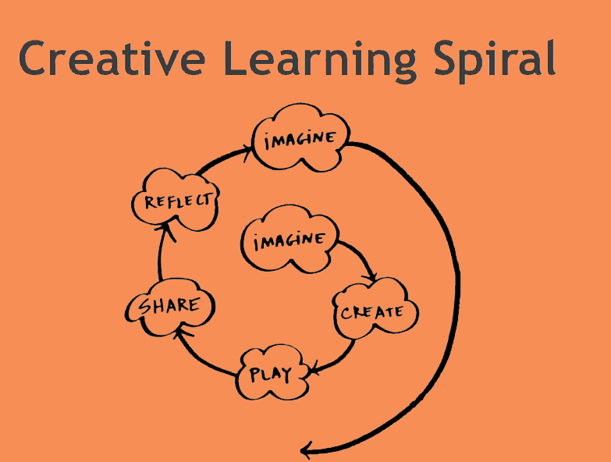
C From c.R.e.A.M Model Style
The letter “C” stands for the word Creativity. Creativity is an intellectual inventiveness. A creative person has confidence to use individual style in his work. He does not follow the style of others; he applies his own imagination to his learning. Creativity makes you stand out of the crowd. To be a creative person always brain storm individually or in a group, always sketch your ideas on a piece of paper and never be afraid of being DIFFERENT from others.

Slide 6
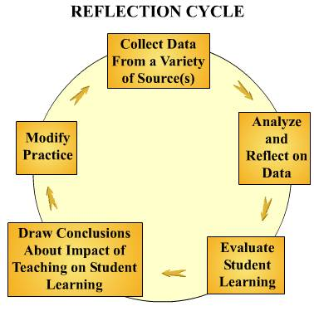
R From c.R.e.A.M Model Style
The Letter “R” stands for the word Reflective.Reflective learning is an action of self-awareness.You must draw lessons form your experience which are learning,studying, discussion,presentation project & a challenging situations. Analyze & evaluate your experience.Observe & evaluate your experience.Ask yourself questions based on what you did during experiencing moments , to improve reflective skills.
“ What did I gain from these lectures ? “
Benefits of Reflective Learning
To Improve problem solving skills,self reflection ,idea & new insights

Slide 7
E From c.R.e.A.M Model Style
“ What is Effective Learning ? ”
Effective learning describes methods of teaching and learning that activity involve peoples in their own learning & personal development.Think of its as children learning how to learn rather than simply parroting information or copying techniques from teachers or other children.It’s proven to help children develop rich language,concentration & exploration skills .
“ What are the effective outcomes of effective learning ? “
Effective learners gain a greater complexity of understanding when it comes to the concepts and information they’ve learned.Effective learners do not absorb or abstract knowledge and information in passive state. They take an active role in their learning & development.Put simply,they are aware of their learning and they learn by doing rather than being told
Therefore effective learners can can reflect their strategies best .

Slide 8
A from c.r.e.a.m model
The letter “A” stands for activeness. An active learner strategy is when you involve yourself personally in work, and then strives to make it happen. To be an active learner one should take part actively in all his projects, make group discussions, do a lot of research and keep moving to achieve a good result.
The Benefits of being active learner in every occupations are as follows :
The knowledge that learning involves the active construction where the learners with
new information what they already know .
It emphasizes the importance of learning through experience rather than absorbing facts verbatim from the teacher or tutor .
A recognition that individuals learn more with others than when they are alone.
They will experience improved self-esteem,finer motor skills,memory recall &
communication teamworks.

Slide 9
M From c.r.e.a.m model
The letter “M” stands for motivated. A motivated learning strategy is when you enjoy learning. To be a motivates learner one should always find ways to make your learning fun and interesting, always think about your goals and keep on working and always think positive, encouraging yourself to do better. Being motivated by something, we can do the work with enthusiasm.A motivated person can perform pretty well than others. Have short-term goals to keep you small successes.
Tips to becoming motivated learner
Need to sure about your aim.
Focus on your ongoings.
Keep calm and do your work regularly.
Learn to follow the lessons precisely

Slide 10





C.R.e.a.m style learning
Creativity
Reflective
effective
active
motivated
Creating Your Own Styles & Strategies
Reflect Yourself
To Self-Awareness
To Become More Effective,Take An Action Roles , Doer
Active Learner Always Have Good Memory Recalls
Stay Motivated To Achieve What You Want To Be

Slide 11
History of Cream style learning
David Kolb published his learning style in 1984. The learning style C.R.E.A.M was named after David Kolb who after many years of study came up with this idea. The main example of C.R.E.A.M learning method seen today in education would be in practical subjects such as home economics, metal work or wood work. Many people including myself find this the most productive way of learning because all the information received is retained and reproduced after being reflected on. Knowing your own learning style enables you to be more productive in the learning environment. As an educator knowing the preferred learning styles of your students is beneficial, grades of a student can improve if you teach them in a way that suits them and maybe not you, but in the end is more beneficial for both.
Constructivism is a theory on how people learn; it includes scientific study and also relies on observations and group studies. It really means that people gain their own knowledge and opinions from experiences and their own personal reflection on those experiences. My overview of constructivism is that it is necessary to obtain information on how we learn and how to make learning easier for people. This is a way of keeping students attention and making hem focus on what they are doing because they are having their own personal experience with the subject.

Slide 12
Thank you Everyone !
Don’t forget to set your goals !
Set both short- and long-term goals.
Set goals that motivate you.
Write your goals down and put them in a place you can see.
Adjust your goals as necessary.
Recognize and reward yourself when you meet a goal.

